Slide 1

Test Automation
Digital Engineering Capability
Kyrylo Mytrofanov 28 June 2019
Notes:
Select one of these pre-defined front pages and delete the rest. This document will be updated regularly to ensure product images are current.
Please note that for all internal presentations you must use the dual brand template, even if your content is single brand. Only use the single brand template
for external presentations, product launches or brand immersion events.

Slide 2



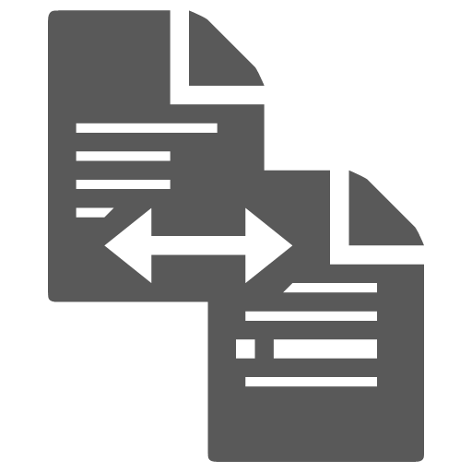







Test Automation Cycle
Full Story
Iterate on Feature File
Explain application context
Describe Data and Checks
Agree Acceptance
Criteria
Business
Customer
Product
Owner
Application
Engineer
Test Automation
Engineer
Backlog
Refining
Add Background
Split Into
Scenarios etc.
Put Calls from
Test Library,
Enrich Test Library
Add Test Checks
User Story
Acceptance Criteria
Given
When
Then
Extraction Script
Feature File
Runnable Test
Automation Stubs
Automated
Test
Test
Report
Work Tracker
Job Orchestrator / Automated Pipeline
Language Processor
Job Orchestrator / Automated Pipeline
Test Management
Notes:
Titles – JLR EMERIC SEMI BOLD 18pt – ALL CAPS
Subtitles – JLR EMERIC 18pt – ALL CAPS
Body copy – JLR Emeric ExtraLight 16pt – sentence case

Slide 3
Test Automation Cycle
POC STAGE or Not Implemented
Iterate on Feature File
Explain application context
Describe Data and Checks
Agree Acceptance
Criteria
Business
Customer
Product
Owner
Application
Engineer
Test Automation
Engineer
Backlog
Refining
Enrich: Add
Background, Split
Into Scenarios etc.
Put Calls from
Test Library,
Enrich Test Library
Add Test Checks
User Story
Acceptance Criteria
Given
When
Then
Extraction Script
Feature File
Runnable Test
Automation Stubs
Automated
Test
Test
Report
Work / Requirements Tracker
Code Storage
Language Processor
Job Orchestrator / Automated Pipeline
Test Management
Notes:
Titles – JLR EMERIC SEMI BOLD 18pt – ALL CAPS
Subtitles – JLR EMERIC 18pt – ALL CAPS
Body copy – JLR Emeric ExtraLight 16pt – sentence case

Slide 4
Test Automation Cycle
Current
Iterate on Feature File
Explain application context
Describe Data and Checks
Agree Acceptance
Criteria
Business
Customer
Product
Owner
Application
Engineer
Test Automation
Engineer
Backlog
Refining
Enrich: Add
Background, Split
Into Scenarios etc.
Put Calls from
Test Library,
Enrich Test Library
Add Test Checks
User Story
Acceptance Criteria
Given
When
Then
Feature File
Runnable Test
Automation Stubs
Automated
Test
Work / Requirements Tracker
Code Storage
Language Processor
Job Orchestrator / Automated Pipeline
Notes:
Titles – JLR EMERIC SEMI BOLD 18pt – ALL CAPS
Subtitles – JLR EMERIC 18pt – ALL CAPS
Body copy – JLR Emeric ExtraLight 16pt – sentence case

Slide 5
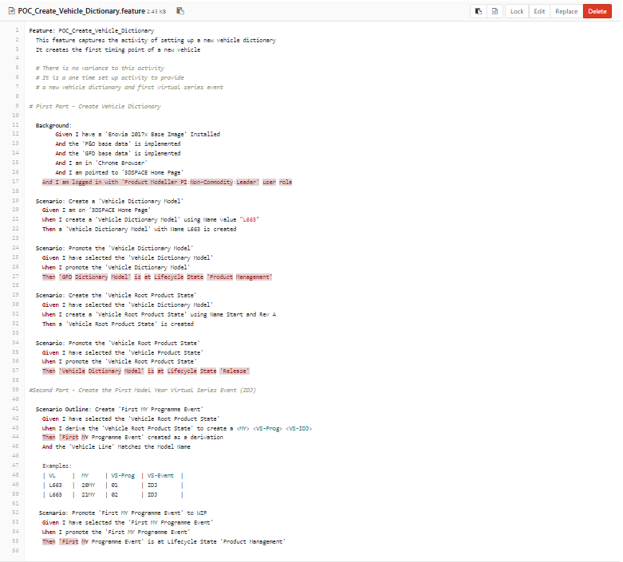
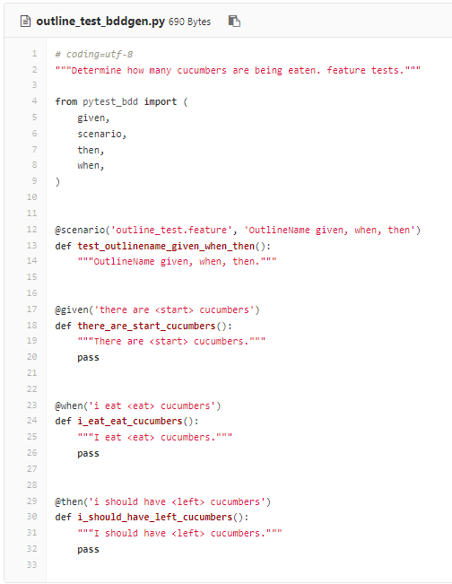
Test Automation Cycle
Cucumber Syntax
Notes:
Titles – JLR EMERIC SEMI BOLD 18pt – ALL CAPS
Subtitles – JLR EMERIC 18pt – ALL CAPS
Body copy – JLR Emeric ExtraLight 16pt – sentence case

